Slide 1


AIR FORUM 2023
New Retention Insights: National Student Clearinghouse & Machine Learning
Steven Sherrin, PhD
Wentworth Institute of Technology

Slide 2
What’s This Presentation About?
I will introduce a machine learning tool that allows institutions to assess retention of students of varying demographic, financial, and academic qualities - comparing results to peer institutions.
I will show how the tool can be used to assess or benchmark retention for any group of students*.
I will demonstrate how to use data mining techniques to discover new retention insights.

Slide 3
What Does The Tool Do?
Data Prep
Machine Learning
Data Insights
Clean and analyze National Student Clearinghouse enrollment data
Prepare and run machine learning models
Select the best machine learning models
Ensure models are fair and accurate
Use machine learning models to compare retention rates by institution and demographic groups
Share data mining tools to discover new retention insights
Integrate NSC data with College Scorecard data

Slide 4

Conceptual
Approach

Slide 5


Example
Female STEM Students
At AIR University

Slide 6


AIR University
3.35 HS GPA
Data Science
3.3 HS GPA
Computer Science
Dataset
3.45 HS GPA
Computer Science

Slide 7






AIR University
Other Institutions
3.35 HS GPA
Data Science
3.25 HS GPA
Information Science
3.3 HS GPA
Computer Science
3.3 HS GPA
Computer Science
Dataset
3.45 HS GPA
Computer Science
3.5 HS GPA
Computer Science & Society

Slide 8
Data &
Methods

Slide 9


Data
Admissions
Enrollment Outcomes
E.g. HS GPA, geographic, socioeconomic data
E.g. Fall-to-fall retention
01
02
03
IPEDS/College Scorecard
Enrollment
Which institution student(s) chose to attend
Link to

Slide 10
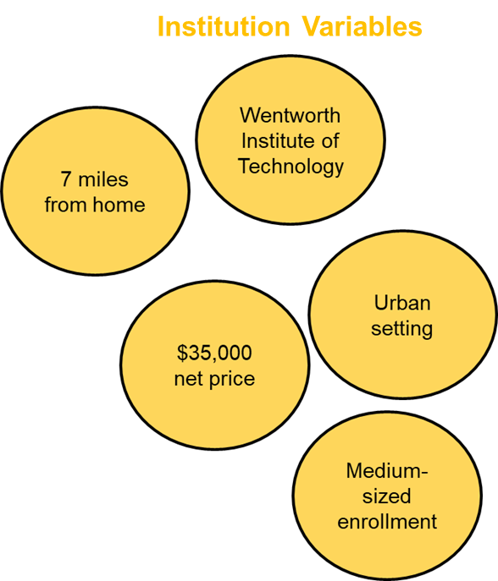
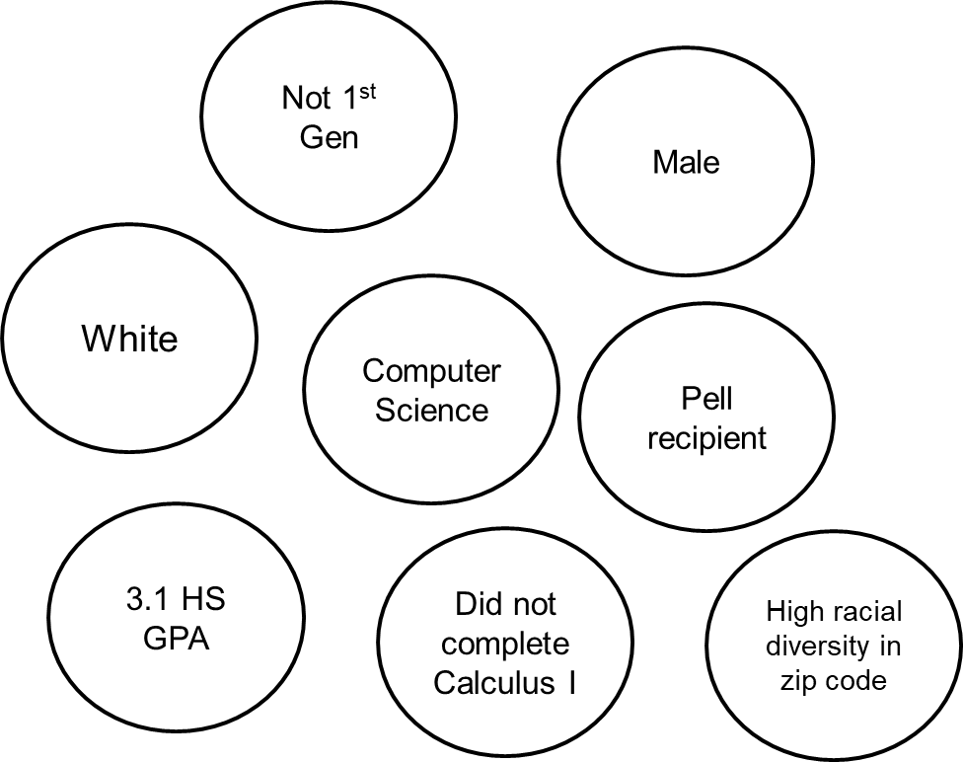

Integrating Data Sources
Student Variables
Institution Variables
National Student Clearinghouse
Persisted
+
=
IPEDS/College Scorecard
Link to

Slide 11

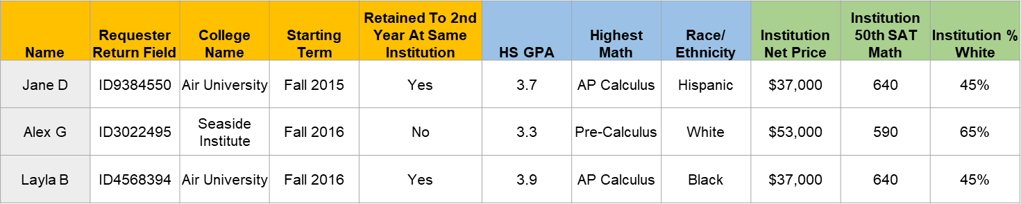


Analytic Plan
Data
Algorithms
Predictions
Generalized additive mixed models (GAMM)
Gradient boosting (GBM) with cross-validation
100s of models tested via hyperparameter tuning.
Ensemble stacking of models
Simple (10 predictors)
Complex (50+ predictors)
Test model performance
Examine model bias
Ensure model fairness
Predictions
Link to

Slide 12
Results

Slide 13



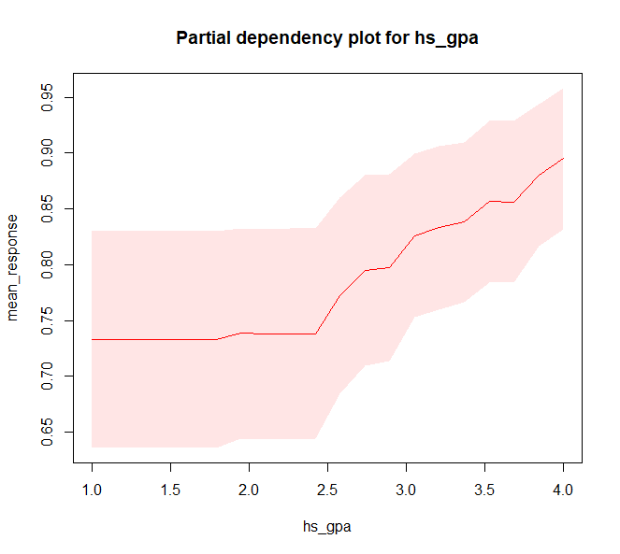
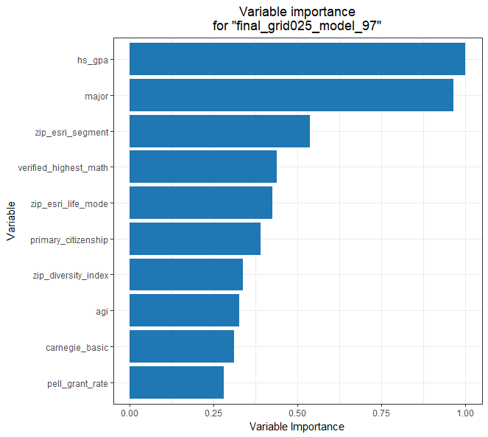

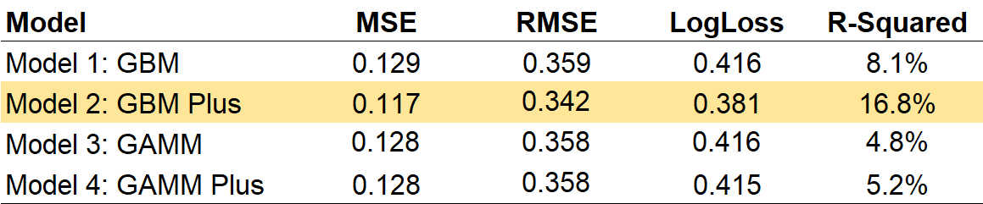
Model Validation
Understand Models
Examine Model Bias
Compare Models

Slide 14
Model Results
Example results

Slide 15
Question #1
“Overall, how are we
doing?”

Slide 16
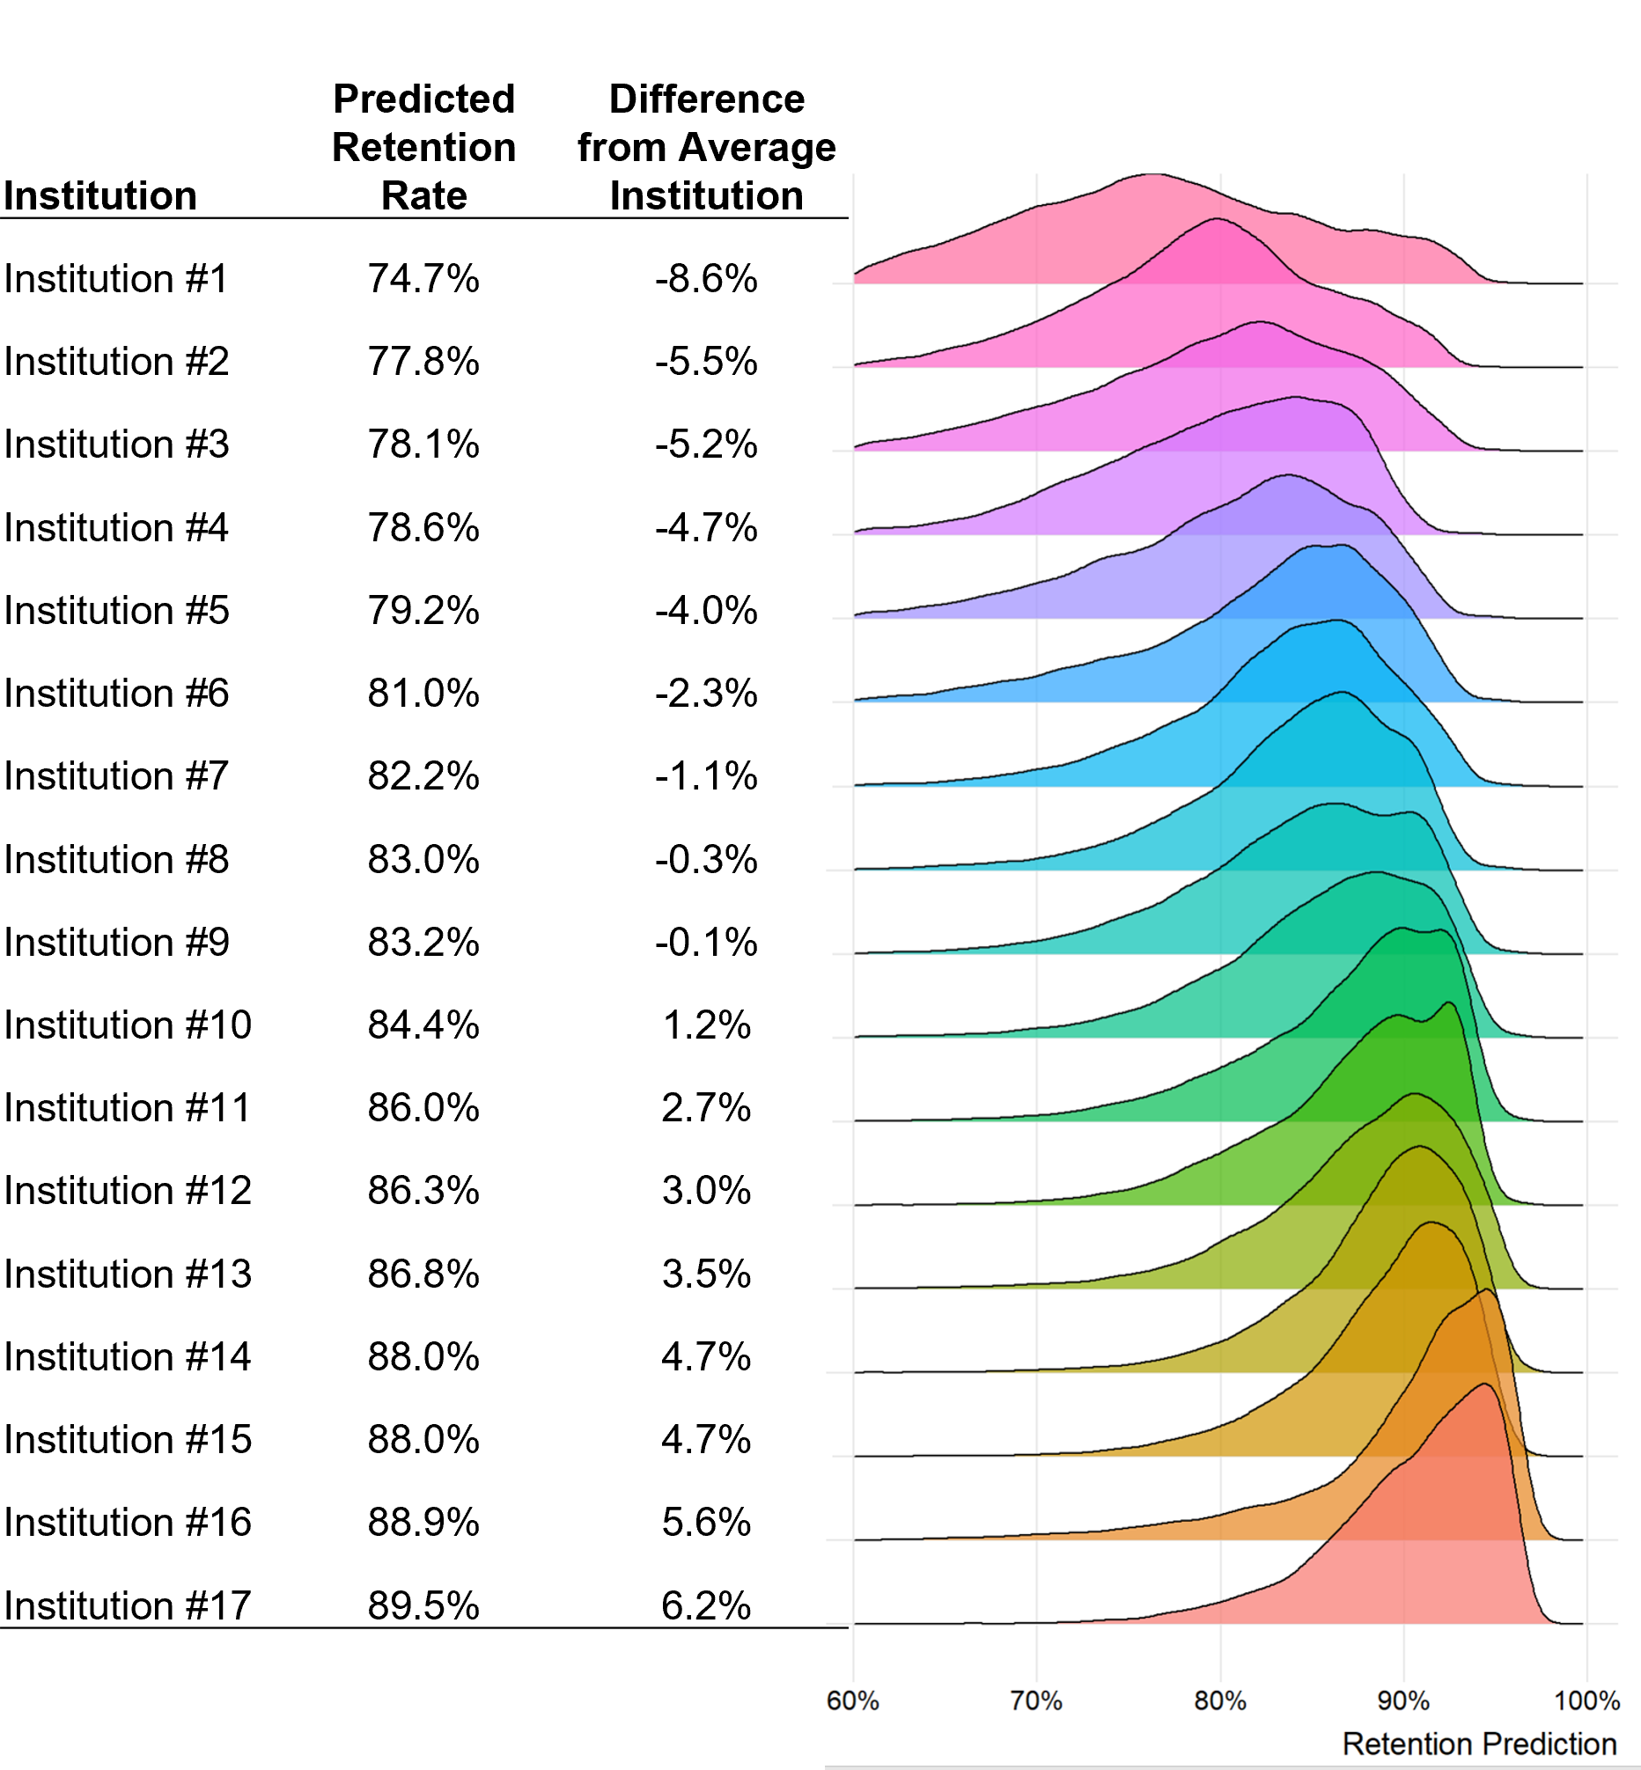
Overall

Slide 17
Question #2
“How are we
doing in retaining
[student group]?”

Slide 18
Female STEM Students

Slide 19

Other Students
Female STEM
Students
Analyze predictions for only these students.

Slide 20
Female STEM
Students
Male STEM
Students
versus
Or, compare predictions between two student groups.

Slide 21
Female STEM
Students
Male STEM
Students
versus
Female STEM
Students
Male STEM
Students
versus
Or, compare predictions between two student groups at two different institutions.

Slide 22
Question #3
“How do we compare our results to schools with higher (or lower) academic selectivity?”

Slide 23
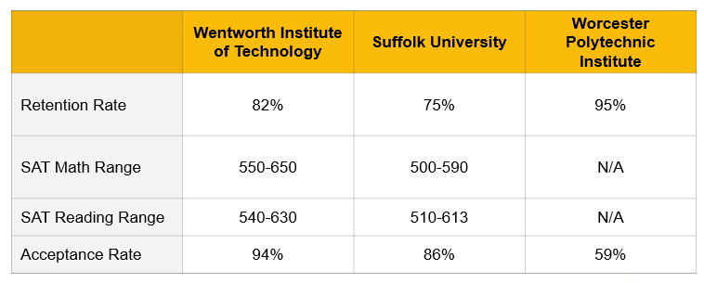
Comparing Institutions by Student Group
You can’t use this. It’s comparing apples to oranges!

Slide 24

Selecting Comparisons
Low HS GPA
High HS GPA
Select students who share attributes in common with students from the institution(s) you want to compare to.

Slide 25
Example
“Our model predicts that among students with high GPAs (3.5 or above), our institution [over- or under-] performs in retention, compared to WPI and other “elite” competitor schools, by ____%.”

Slide 26
Question 4
“Did your super-fancy model tell us anything we don’t know/discover anything new?”

Slide 27
Discovering New Insights
Use data mining techniques to discover new insights.
Example:
Surrogate modeling of machine learning model.
A decision tree that predicts the biggest predicted retention differences at your institution compared to other institutions.

Slide 28
Summary

Slide 29
Summary
This tool enables institutions to assess retention of students of varying demographic, financial, and academic qualities.
Can be used to assess retention for any group of students (*with sufficient sample size).
Exploring model can uncover previously unknown retention insights.

Slide 30

Thank You!
Steven Sherrin, Ph.D.
sherrins@wit.edu

Slide 31

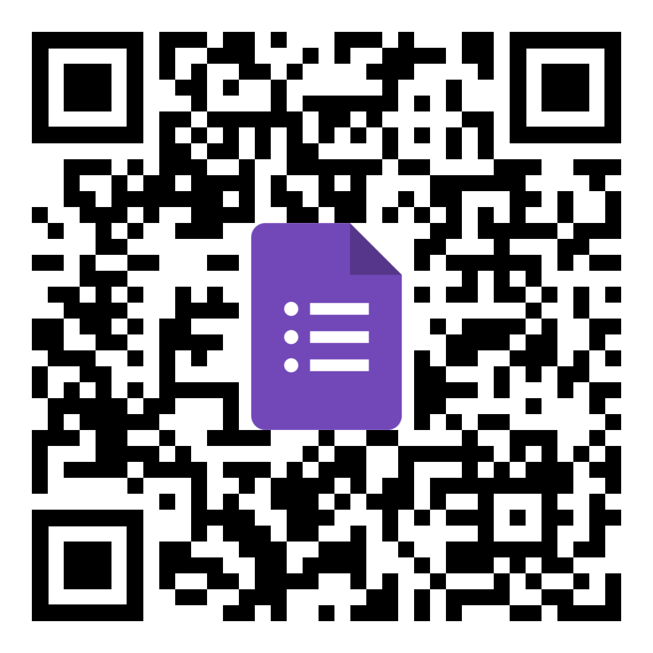

Thank You!
Statistics, Methods, & Code
Do You Want To Collaborate?
Connect With Me

